Slide 1
Healthsphere: Intelligent Health Companion
PIP2001 Capstone Project
VIVA-VOCA
Batch Number: CSD-G12
Under the Supervision of,
Dr Madhusudhan M V
Associate Professor
School of Computer Science and Engineering
Presidency University
20211CSD0127 | K PAVADHARANI
20211CSD0045 | KHUSHI S M
20211CSD0115 | AKSHATHA C
Roll Number | Student Name
Name of the Program: B.Tech [CSE-Data science]
Name of the HoD: Dr. Saira Banu Atham
Name of the Program Project Coordinator: Dr. Manjula H M
Name of the School Project Coordinators: Dr. Sampath A K / Dr. Abdul Khadar A / Mr. Md Ziaur Rahman

Slide 2
Introduction
Healthsphere integrates advanced technologies, including machine learning and Firebase, to create a seamless experience for users.
It allows individuals to input their daily food consumption and physical data, such as height, weight, and water intake.
Using these inputs, the app generates precise nutritional analyses, predicts possible deficiencies, and offers tailored recommendations.
The application also tracks water intake and physical activities, encouraging users to stay hydrated and active.
Through machine learning, the platform enhances user experience by providing real-time insights and actionable recommendations.

Slide 3
Literature Review
AUTHORS | TITLE OF THE PAPER | WHEN WAS IT PUBLISHED | UNDERSTANDING OF THE PAPER
Comendador, B. E. V., Francisco, B. M., Medenilla, J. S., Nacion, S. M. T., & Serac, T. B. E. | Pharmabot: A Pediatric Generic Medicine Consultant Chatbot | 2015 | A pediatric medicine chatbot using visual C# and MS Access, with limited scope, standalone access, and input constraints.
Seema, J., Suman, S., Chirag, S. R., Vinay, G., & Balakrishna, D | Doctor Chatbot – Smart Health Prediction | 2021 | Uses Dialogflow and SVM to predict heart disease, offering accessible diagnosis but reliant on input accuracy
Huang, C.-Y., Yang, M.-C., Huang, C.-Y., Chen, Y.-J., Wu, M.-L., & Chen, K.-W. | A Chatbot-Supported Smart Wireless Interactive Healthcare System for Weight Control and Health Promotion | 2018 | An AI-driven mobile chatbot for health monitoring, providing personalized feedback but limited to Android devices

Slide 4
Literature Review
AUTHORS | TITLE OF THE PAPER | WHEN WAS IT PUBLISHED | UNDERSTANDING OF THE PAPER
Kazi, H., Chowdhry, B. S., & Memon, Z. | MedChatBot: An UMLS-Based Chatbot for Medical Students | 2012 | Leveraging UMLS and AIML for quick learning, but limited by UMLS in handling complex queries.
Samoggia, A., Bordoni, A., & Monticone, F | Data on the Potential of Nutrition-Information Apps from a Consumer Behaviour Perspective | 2020 | Improved healthy eating awareness and behavior, despite reliance on self-reported data and usage barriers
Khan, M. A., Bibi, M., Ahmad, M., Shah, S. T., & Ullah, Z. | Mobile Apps for Human Nutrition: A Review | 2020 | Reviewed nutrition apps that track diet and fitness, offering convenience and personalized insights but facing reliability issues with self-reported data.

Slide 5
Research Gaps Identified
Limited Emotional Intelligence in Chatbots
Lack of Comprehensive Integration in Nutrition and Fitness Tracking
Data Personalization and Predictive Accuracy
Challenges in Securing and Managing Sensitive Health Data
User Engagement and Long-Term Behavior Change
Real-Time Context Awareness
Scalability and Performance Optimization

Slide 6
Proposed Method
Healthsphere addresses the limitations of existing apps by providing:
Diet Analysis
Exercise Tracking
Hydration Monitoring
Personalized Recommendations
Real-Time Data Handling

Slide 7
Objectives
The primary objective of this project is to develop a comprehensive web-based health analyser that empowers users to:
Assess their daily nutrition and detect potential deficiencies in vitamins, proteins, and other key nutrients.
Calculate and track their BMI to understand their physical health category.
Monitor water intake and provide hydration reminders.
Suggest personalized exercise routines and lifestyle changes to improve overall health.
Track user’s physical activity with multiple options and analyze the calories burnt.

Slide 8
System Design and Implementation
User Input Module
Nutritional Analysis Module
Exercise Tracking Module
Hydration Reminder Module
Recommendation System
Backend Data Storage Module

Slide 9
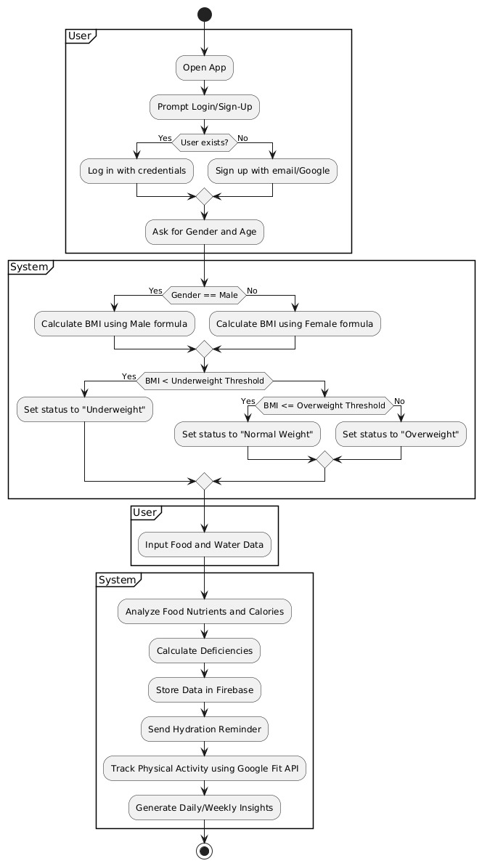
Architecture
The two roles included are:
User
System

Slide 10
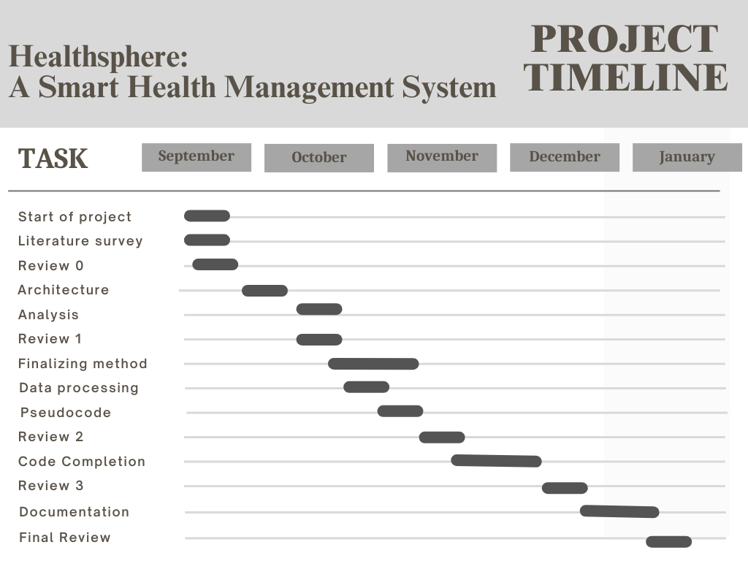
Timeline of Project

Slide 11
Outcomes Obtained
1. Nutritional Awareness
2. Health Risk Awareness
3. Hydration Tracking
4. Physical Activity Monitoring
5. User Engagement
6. Machine Learning Performance

Slide 12
Conclusion
Healthsphere leverages AI and machine learning to deliver personalized health insights, empowering users to make proactive wellness decisions. It integrates nutrition tracking, caloric and nutrient analysis, and deficiency prediction, addressing challenges in managing dietary intake. With Google Fit API integration, users can seamlessly track physical activity alongside nutrition data for a holistic health view. Built on Firebase, it ensures secure data storage and privacy while offering real-time nutrient analysis, caloric estimation, hydration reminders, and activity notifications to foster healthy habits. Future advancements may include condition-specific dietary guidance, wearable integration, and trend forecasting, making Healthsphere a comprehensive wellness management tool.

Slide 13
Github Link
https://github.com/dharani26203/HealthyBuddy

Slide 14
References
Pharmabot: A Pediatric Generic Medicine Consultant Chatbot https://www.joace.org/uploadfile/2014/0801/20140801025000959.pdf
Doctor Chatbot – Smart Health Prediction https://www.researchgate.net/publication/353115062_Doctor_Chatbot_-_Smart_Health_Prediction
A Chatbot-supported Smart Wireless Interactive Healthcare System for Weight Control and Health Promotion. https://www.researchgate.net/publication/330387982_A_Chatbot-supported_Smart_Wireless_Interactive_Healthcare_System_for_Weight_Control_and_Health_Promotion
Understanding the Role of Healthy Eating and Fitness Mobile Apps in the Formation of Maladaptive Eating and Exercise Behaviors in Young People. https://pmc.ncbi.nlm.nih.gov/articles/PMC6604512/
Diet and Physical Activity Apps: Perceived Effectiveness by App Users. https://pmc.ncbi.nlm.nih.gov/articles/PMC4840256/
Mobile Apps for Human Nutrition: A Review. https://www.researchgate.net/publication/339492054_Mobile_Apps_for_Human_Nutrition_A_Review
Data on the potential of nutrition-information apps from a consumer behaviour perspective https://www.researchgate.net/publication/340743010_Data_on_the_potential_of_nutrition-information_apps_from_a_consumer_behaviour_perspective
MedChatBot: An UMLS based Chatbot for Medical Students https://www.researchgate.net/publication/258652010_MedChatBot_An_UMLS_based_Chatbot_for_Medical_Students

Slide 15
Publication Details
Machine Graphics and Vision (Q4)
InderScience Submissions (Q4)
International Journal of Multidisciplinary Research (Q4)
RAMP2023 (Q4)
Publishing Research Quarterly (Q4)
Engineering Letters (Q4)
International Journal of Computer Theory and Engineering (Q4)
Journal of Information Systems Security(Q4)
Journal of Emerging Technologies and Innovative Research (Q4)

Slide 16
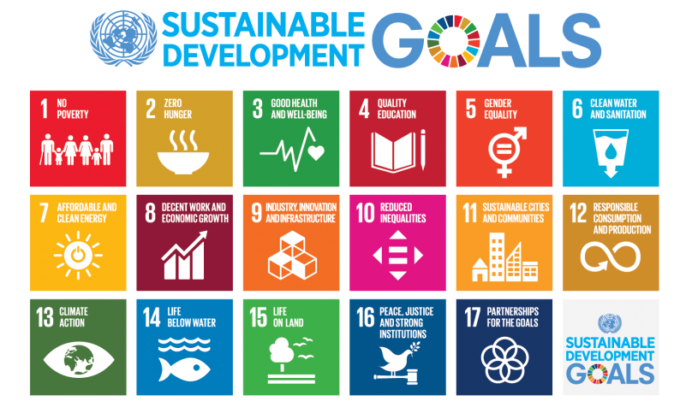
Project work mapping with SDG
The project described aligns with Sustainable Development Goal (SDG) 3: Good Health and Well-Being.
SDG 3 focuses on ensuring healthy lives and promoting well-being for all at all ages. The project aims to address critical healthcare challenges, including diet, by using technology to save time, provide immediate assistance, and improve the efficiency of resource management.

Slide 17
Thank You

